Slide 1
Tomographic reconstruction from projections with unknown view angles
Arunabh Ghosh

Slide 2
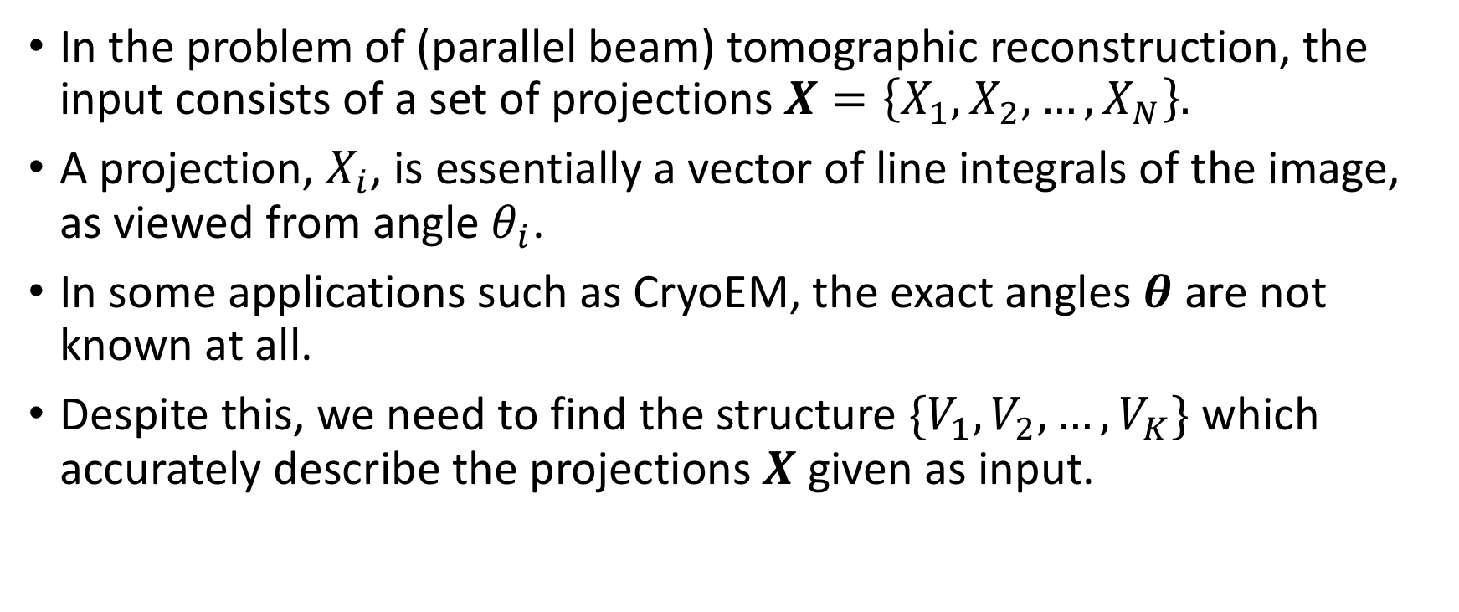
Introduction
In the problem of (parallel beam) tomographic reconstruction, the input consists of a set of projections $X=\left\{X_{1}, X_{2},…,X_{N}\right\}.$
A projection, $X_{i}$, is essentially a vector of line integrals of the image, as viewed from angle $θ_{i}$.
In some applications such as CryoEM, the exact angles $θ$ are not known at all.
Despite this, we need to find the structure ${\{V}_{1},V_{2},…, V_{K}\}$ which accurately describe the projections $X$ given as input.

Slide 3

Optimization framework
Formally, structure determination may be described in a Bayesian likelihood framework:
$$arg max_{\{V_{1}, V_{2},.., V_{K}\}} log p(V_{1}, V_{2},…,V_{K}|X_{1}, X_{2},…,X_{N})$$
$$=arg max_{\left\{V_{1}, V_{2},.., V_{K}\right\}}log p\left(X_{1,…,N} | V_{1,…K}\right) + log p\left(V_{1}, V_{2},.., V_{K}\right)$$

